Slide 1
Building Enterprise Applications
Insights gained during training at Calibo
Gurivi Reddy Yasaswini

Slide 2
What is an Enterprise Application?
An Enterprise application is a large-scale software system designed to support core business processes across departments, users, and geographies.
It focuses on scalability, reliability, security, integration, and maintainability. It can support thousands or millions of users and handle critical business operations.
Real World Examples: Microsoft Teams, Outlook, Banking systems used by banks like State Bank of India, Airline reservation systems used by airlines like IndiGo

Slide 3
Enterprise System Design Principles
Scale & Load
Handle high traffic by distributing requests across multiple servers
Security & Compliance
Protect data and control access using authentication, authorization (IAM), and regulatory policies.
Performance & Latency
Improve system speed using caching, CDNs, and asynchronous processing
Observability & Operations
Monitor system health using metrics, logs, tracing, and alerts.

Slide 4
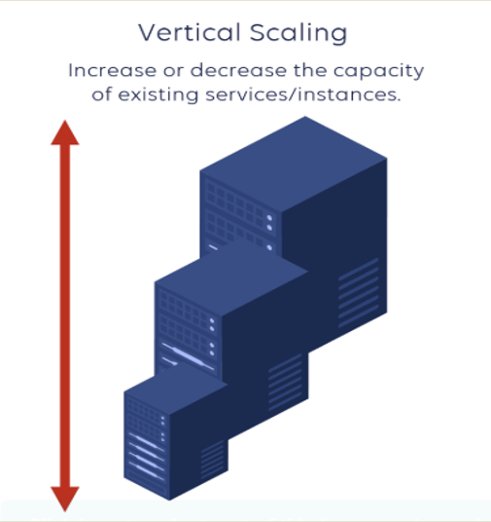
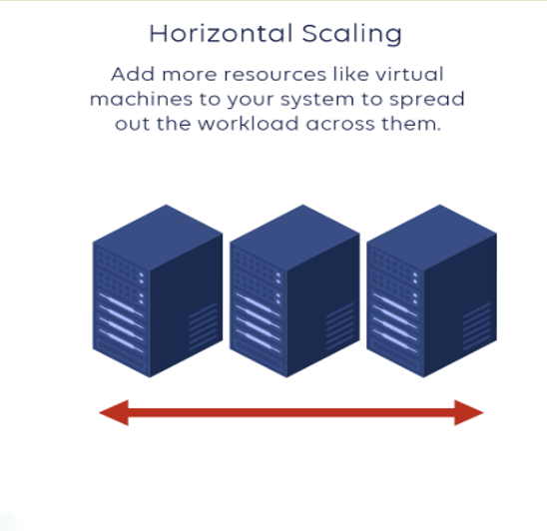
Upgrading a virtual machine in Amazon Web Services Amazon EC2 from 2 CPU and 4 GB RAM to 8 CPU and 16 GB RAM.
A cloud server increases its storage capacity from 100 GB to 1 TB to store more data.

Slide 5
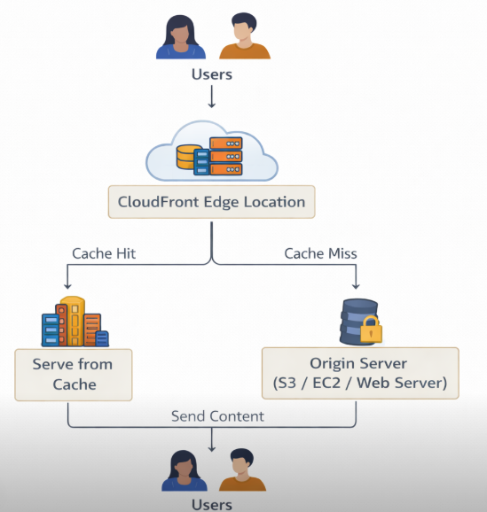
Amazon CloudFront is a Content Delivery Network (CDN) that delivers data, videos, and applications to users with low latency.
It distributes content through a global network of edge locations to improve speed.
It integrates with services like Amazon Web Services storage and servers to securely deliver content.

Slide 6
Functional Requirements | Non-Functional Requirements
Student Analogy : Attend classes, Write exams | Student Analogy : Discipline ,Focus , Consistency, Punctuality
Describe what the system should do | Describe how the system should perform
Define features and functions of the system | Define quality attributes of the system
Represent user interactions and system behavior | Focus on performance, security, reliability
Examples: User login, Order placement, Payment processing | Examples: Fast response timeScalability, Audit Trails, Data Processing Time, PII Compliance

Slide 7
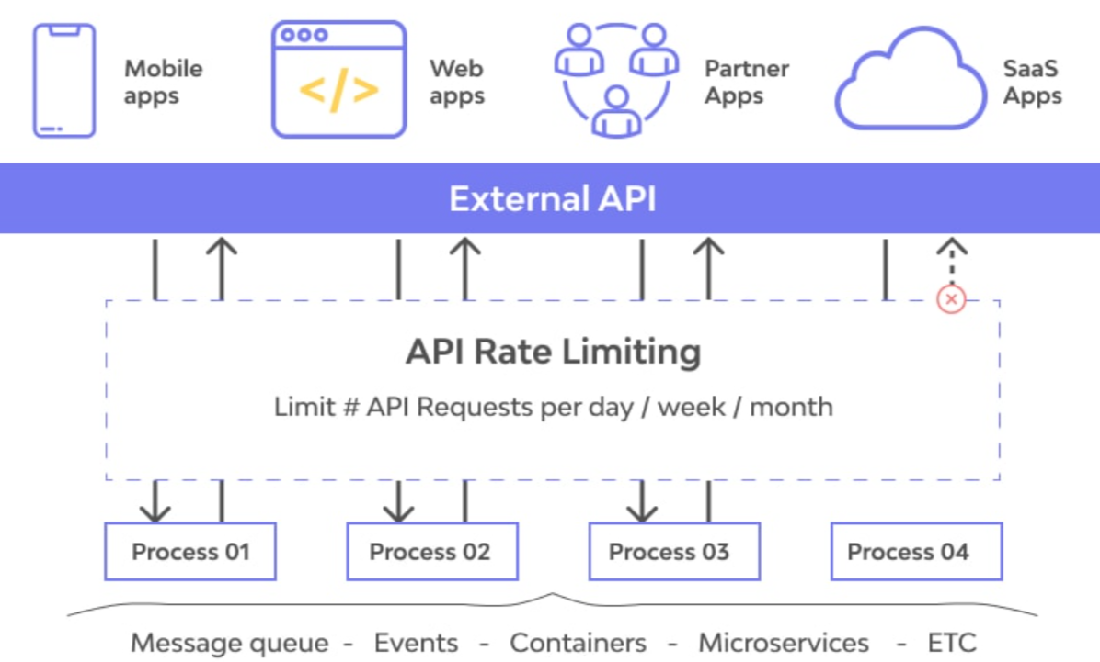
API Gateway
Acts as a single entry point for all client requests to backend services.
Handles security, routing, monitoring, and traffic control.
Rate Limiting
Limits the number of API requests a user can make in a given time period.
Example: 100 requests per minute per user.
Helps prevent API abuse and excessive usage.
Throttling
Controls the speed of incoming API requests when traffic is too high.
Extra requests are delayed or rejected.
Protects the system from overload and performance issues.

Slide 8
Best Practices
API Design
Versioning Strategy
Use semantic versioning (v1, v2, v3) to manage updates without breaking existing consumers.
Support parallel API versions to allow a smooth migration from legacy to modern services.
Implement feature flags to control feature rollouts.
Architectural Style Selection
REST (Representational State Transfer) – Best for public APIs with broad client compatibility
Consistent Resource Naming & Structure
Use nouns for resources (/orders, /patients, /labs) and verbs for actions (POST /orders, PATCH /orders/{id}).
Follow plural naming conventions for collections (/users instead of /user).
Implement query parameters for filtering (/orders?status=pending).
Error Handling & Standardized Responses
Use standard HTTP status codes:
200 OK – Successful request
201 Created – Resource successfully created
400 Bad Request – Invalid input
401 Unauthorized – Authentication required
404 Not Found – Resource doesn’t exist
500 Internal Server Error – System failure
Return structured error messages with clear descriptions
Security & Compliance
API Observability & Monitoring
Authentication & Authorization
Use OAuth 2.0 / OpenID Connect for secure authentication.
Implement RBAC (Role-Based Access Control)
Enforce API keys, JWT (JSON Web Tokens), or mTLS (Mutual TLS).
Rate Limiting & Throttling
Use API gateways to prevent abuse with:
Rate limiting (X requests per second per user)
Throttling (slowing down API requests if limits are exceeded)
Circuit breakers to prevent cascading failures.
Secure Data Handling
Encrypt sensitive data using TLS 1.2+.
Mask Personally Identifiable Information (PII).
Use audit logging for compliance tracking.
API Metrics, Logging & Tracing
Monitor key metrics such as latency, error rates, and request volume.
Store structured logs in AWS CloudWatch, ELK Stack, or Datadog.
Implement tracing mechanisms (e.g., OpenTelemetry, Jaeger, Zipkin) to trace requests across microservices.
Use API Gateway health monitoring (/health endpoint) for real-time status checks

Slide 9
Synchronous Communication | Asynchronous communication (Fire-and-Forget)
Sender waits for a response | Sender does not wait for a response
Communication happens in real time | Communication happens in background
Slower if the service is busy | Faster and more scalable
Example: API request → response When a user logs in, the application sends credentials to the authentication service and waits for the response before granting access | Example: Message queue(SQS) / event system Services send logs to a logging system asynchronously so the application can continue running without waiting for a response

Slide 10
Monolithic Architecture | Microservices Architecture
Single large application | Many small independent services
All components tightly connected | Services are loosely connected
Hard to scale parts separately | Easy to scale each service
One failure can affect whole system | Failure affects only one service
Simple to start development | Better for large and complex systems

Slide 11
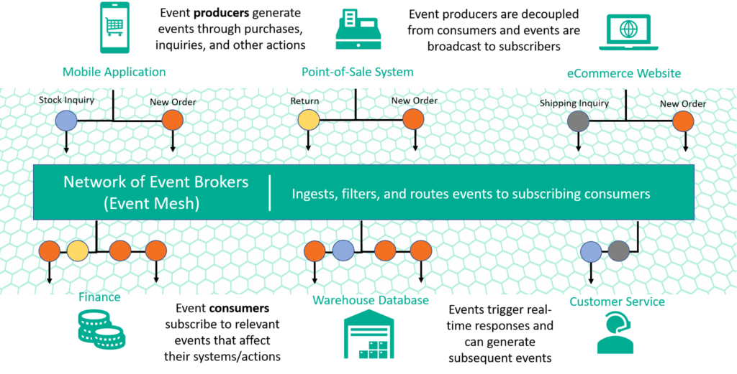
Event Driven Microservices
Monolith → Microservices → Event Based Microservices
Api->publish events.
Decoupling Through Asynchronous Communication
Event Streams as a Reliable Source of Truth
Smarter, On-Demand Scaling
e.g. Real-time order updates automatically synchronize across inventory, shipping, and payments. Better customer experience through accurate, up-to-date order tracking.

Slide 12
Domain-Driven Design (DDD)
Domain-Driven Design (DDD) is a software design approach that focuses on understanding the business domain and building software that matches business needs and logic.
Key Concepts
Ubiquitous Language: A common language shared by developers and business experts to avoid confusion.
Bounded Context: A clear boundary where a specific model or service works.
Sub-domains: Smaller parts of a business domain that divide complex problems

Slide 13
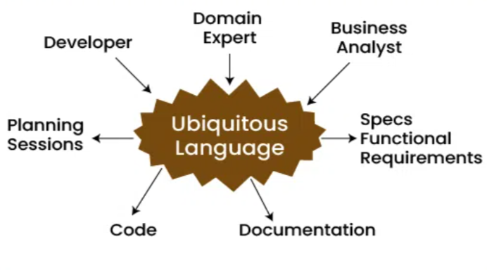
Problem Space Definition
Domain-Driven Design (DDD) helps teams understand, model, and segment complex business problems by aligning technical solutions with the business domain.
DDD allow teams to:
Identify the problem space through domain exploration and business logic segmentation.
Avoid monolithic, tightly coupled architectures by creating modular, context-specific solutions.
Improve collaboration between domain experts and developers using a shared domain language.
Core Domain – Main business logic that gives competitive advantage (Example: Order processing in an e-commerce system).
Supporting Domain – Helps the core domain operate smoothly (Example: Product catalog or customer management).
Generic Domain – Common functionalities used in many systems (Example: Login authentication or email notifications).

Slide 14
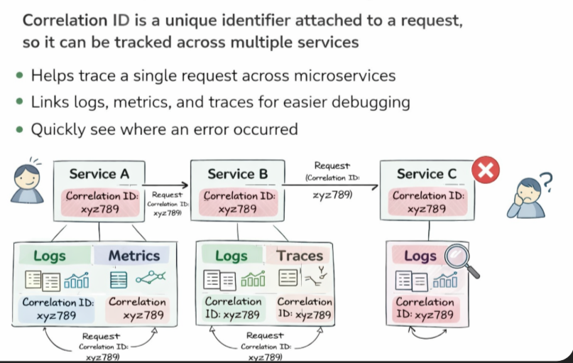
A Correlation ID is a unique identifier attached to a request so it can be tracked across multiple services.
It helps trace a single request across microservices.
It links logs, metrics, and traces, making debugging easier.
It allows developers to quickly identify where an error occurred in the system.

Slide 15
Types of Logs
Log Type | Purpose | Example
Error Log | Indicates something failed | Payment processing failed for order_id=5001 at 2026-03-12 10:15:30
Warning Log | Something unusual happened but not critical | Disk space low on server-2 at 2026-03-12 10:16:00
Info Log | Normal events or actions | User login successful for user_id=101 at 2026-03-12 10:16:30
Debug Log | For developers to trace program flow | API response payload: {"status":"ok"} at 2026-03-12 10:17:00
Trace Log | Very fine-grained details for tracing | Entering function calculateTax() with params amount=500 at 2026-03-12 10:17:10
Fatal Log | Severe errors that usually stop the application | Out of memory, shutting down process at 2026-03-12 10:17:30
Audit Log | Records important user actions for security/compliance | User 101 changed password at 2026-03-12 10:18:00
Event Log | Specific events or state changes in the system | New order placed with order_id=5002 at 2026-03-12 10:18:30

Slide 16
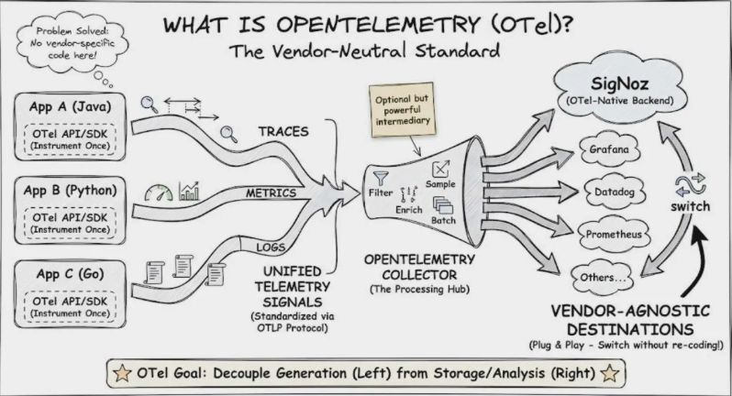
OpenTelemetry (OTel) collects logs, metrics, and traces from applications. It helps in monitoring, debugging, and analyzing performance in cloud environments. Data is sent to cloud backends like CloudWatch, Grafana, or Jaeger for visualization.
Traces are commonly visualized using tools like SigNoz or Datadog to track request flow. Metrics are usually collected with Prometheus and visualized in Grafana. Logs are stored and analyzed using tools like SigNoz or Datadog

Slide 17
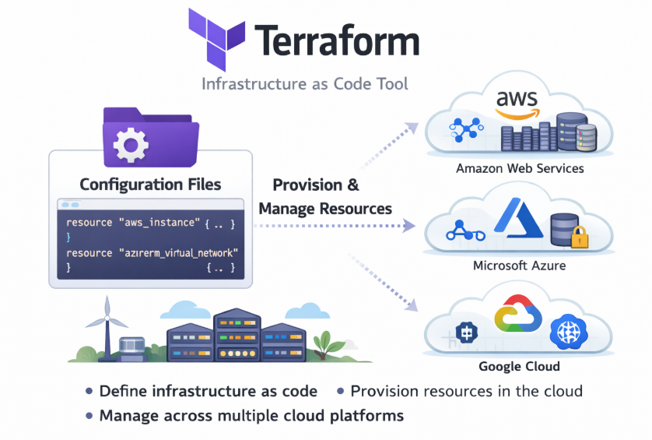
Terraform is an Infrastructure as Code (IaC) tool used to create and manage cloud resources.
It allows developers to define infrastructure using simple configuration files.
Terraform automatically provisions and updates resources across cloud providers like Amazon Web Services, Microsoft Azure, and Google Cloud.

Slide 18
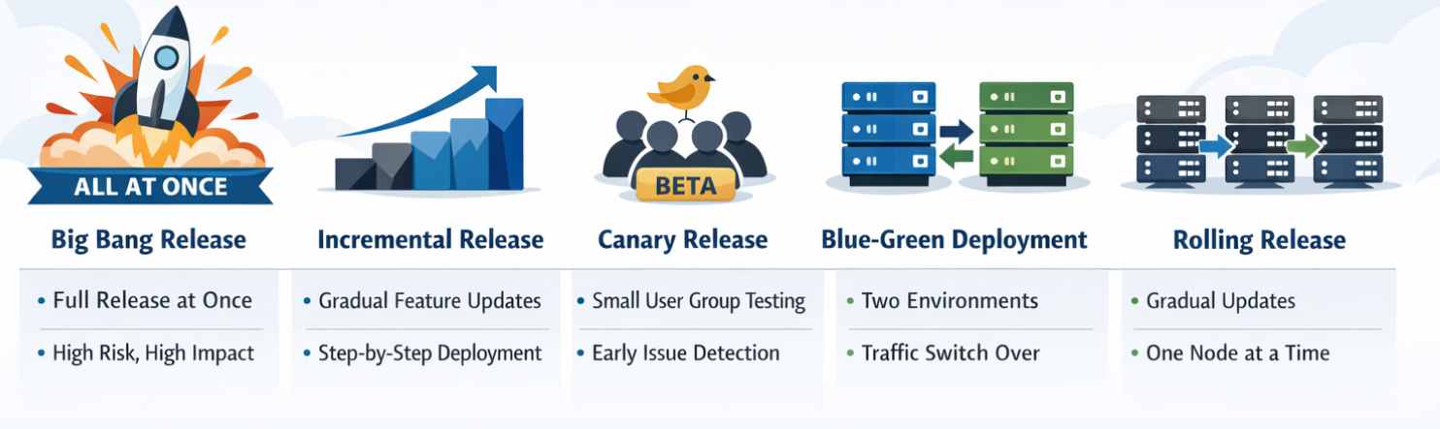

Release Strategy means the planned approach a team uses to deliver software updates or new versions to users.

Slide 19

Thank you for staying with me till the end! 😊

